Slide 1


Project Hermes
John Simmons, Matt olan, William Mak, Anthony Kalsatos, Kyle Lubienecki, Jeremy Guan,

Slide 2

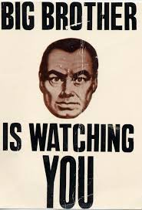


Our Solution
traditional Data storage
+
+
High investment
Tiny Storage
Privacy Issues

Slide 3



Our solution
Massive User generated data
Data Storage interface

Slide 4
How it works / DEMO?
Turn your Computer into a Data Centre
Anonymous
Little start-up investment
Larger potential for data

Slide 5

QUESTIONTIME.
PLEASE, DON’T BE AFRAID!

